Slide 1

Customer Retention Case Study Presented by Vaishnavi Kalambhe

Slide 2
AGENDA
Introduction
Problem Statement
Problem Analysis
Description of Customer Retention
Importance and Benefits of Customer Retention
Data Analysis of the Dataset
Understanding through Visualization
Assumption
Concluding Statement

Slide 3
Introduction
With the rapid global growth in electronic commerce (e-commerce), businesses are attempting to gain a competitive advantage by using e-commerce to interact with consumers.
Today, online shopping is a fastest-growing area. Growing number of consumers, shop online to purchase goods and services, gather product information or even browse for enjoyment. Online shopping environments is therefore playing an increasing role in the overall relationship between marketers and their consumers.
In this presentation we will be looking at the analysis made on the customer retention rate for Indian e-commerce companies.
We will be analysing the customers retention rate and e-commerce success rate with the help of a survey answered by the customers on online retail companies and the factors that influence their purchase decision.
This analysis includes the expectations, reliability, trustworthiness etc of the customers on a good e-tailer store.

Slide 4
Problem Statement
The online purchasing rate increasing day by day. Customers’ satisfaction is most important for any business development. The first question that comes into our mind is “What individual factors motivate a buyer to purchase online as well as restrain to purchase online?”.
Customer satisfaction has emerged as one of the most important factors that guarantee the success of online store; it has been posited as a key stimulant of purchase, repurchase intentions and customer loyalty. A comprehensive review of the literature, theories and models have been carried out to propose the models for customer activation and customer retention. Five major factors that contributed to the success of an e-commerce store have been identified as: service quality, system quality, information quality, trust and net benefit. The research furthermore investigated the factors that influence the online customers repeat purchase intention. The combination of both utilitarian value and hedonistic values are needed to affect the repeat purchase intention (loyalty) positively. The data is collected from the Indian online shoppers. Results indicate the e-retail success factors, which are very much critical for customer satisfaction.

Slide 5
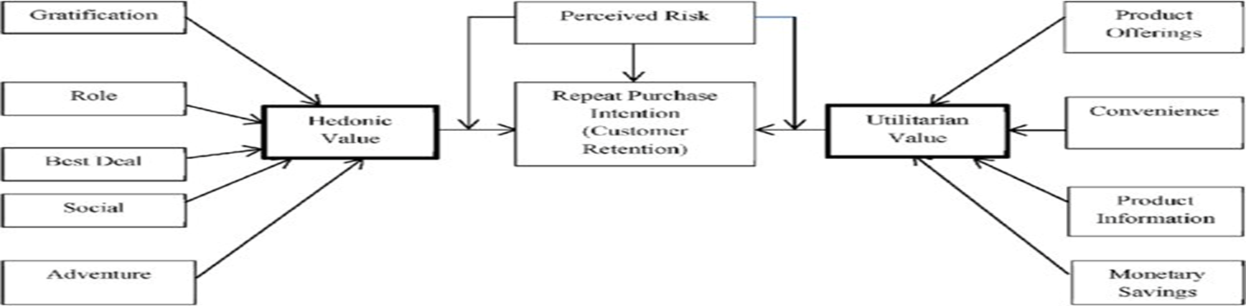
Utilitarian value: Utilitarian value is an objective value which provides some functional benefits to the consumers and helps consumers to accomplish practical tasks.
Hedonistic value: Hedonistic value is subjective (Psychological) value which provides an experiential satisfaction. In other words, the immediate psychological gratification that comes from experiencing some activity or from consumption of a product

Slide 6
Problem Analysis
The problem statement shows how customers form expectations on technology based self-service quality and suggested five main attributes of ecommerce store quality, that are service quality, system quality, information quality, trust and net benefit.
Many businesses focus on customer loyalty programs to remain competitive in today's marketplaces and explore innovative ways to keep their existing customers engaged. Customer retention is a simple concept. Yet, it often requires effort from every department to improve the customer experience and build lasting trust. So, what is customer retention and why it is so important. Let’s know about it by analysing the problem.

Slide 7
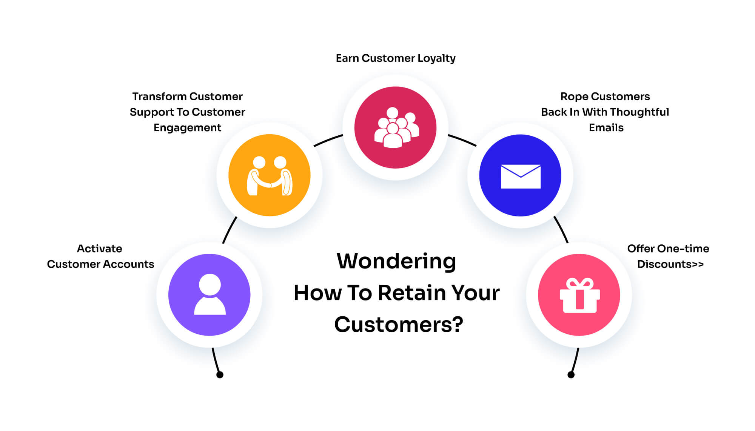
What is Customer Retention ?
Customer retention refers to the activities and actions companies and organizations take to reduce the number of customer defections. The goal of customer retention programs is to help companies retain as many customers as possible, often through customer loyalty and brand loyalty initiatives. It is important to remember that customer retention begins with the first contact a customer has with a company and continues throughout the entire lifetime of the relationship.

Slide 8
Importance of Customer Retention
Lower Marketing Costs
Repeat Purchases Means Repeat Profit
Free Word-Of-Mouth Advertising
Gain Valuable Feedback
Previous Customers Will Pay Premium Prices

Slide 9
Benefits of Customer Retention
Retention is more cost effective than acquisition.
Loyal customers provide excellent word of mouth referrals.
Return customers are more profitable.
Regular customers provide more feedback.
Your brand will stand out from the crowd.
Customers will explore your brand.

Slide 10










Data Analysis of the Data Set:

Slide 11
Exploratory Data Analysis (EDA) Steps
Imported the dataset in the Jupyter notebook.
Performed some of the statistical analysis like dimension of the dataset, data types, info, number of unique values, value counts etc.
The column names in the dataset were not in the proper format so, renaming them for better understanding.

Slide 12
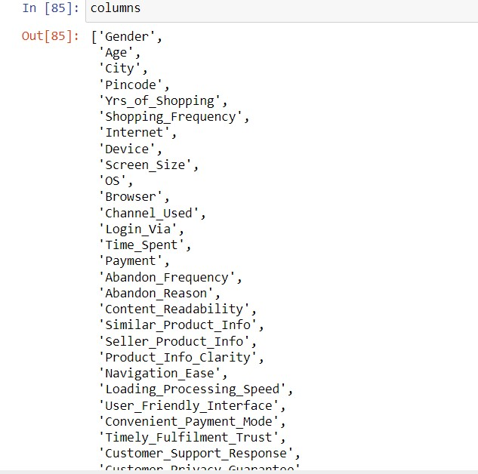
New Column Names:

Slide 13
EDA Steps
Checked the null values and found no null values in the dataset.
Performed both univariate and bivariate analysis and visualized each feature using seaborn and matplotlib libraries by plotting count plot, pie plot, distribution plot, box plot and factor plot.

Slide 14
Data Visualization
The data visualization is divided into 2 parts. Mainly there are 2 categories in which visualization is divided for the convenience of understanding.
Univariate Analysis (this the first category of data. It has mostly categorical and numerical data)
Bivariate analysis(Experiences of customers) The experience of customers about the online shopping/product buying can be represented and in the dataset the questions are asked in the form of polls.
Bivariate Analysis(different platforms) The different platforms used by the customers for online shopping or buying products, and their preferences with respect to websites/apps can be showcased. The visualization of data has to be divided into different parts. As there are 71 columns in the dataset it is not possible to showcase those in charts individually.

Slide 15
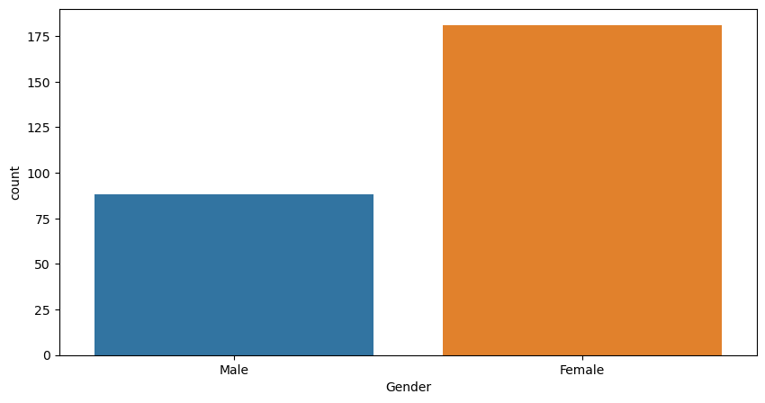
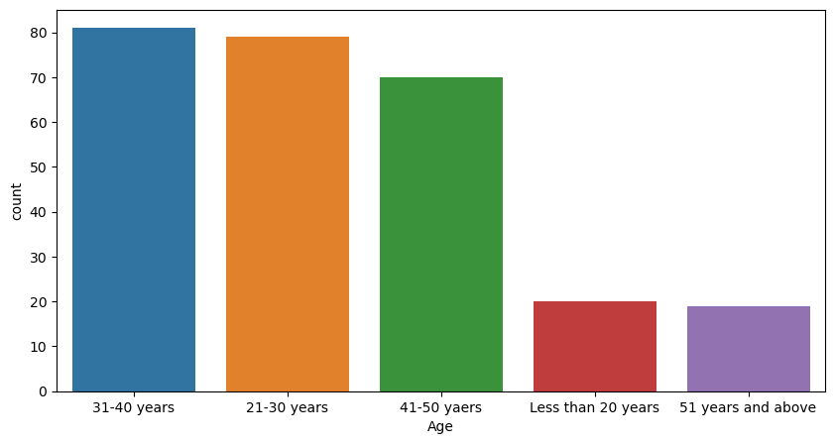
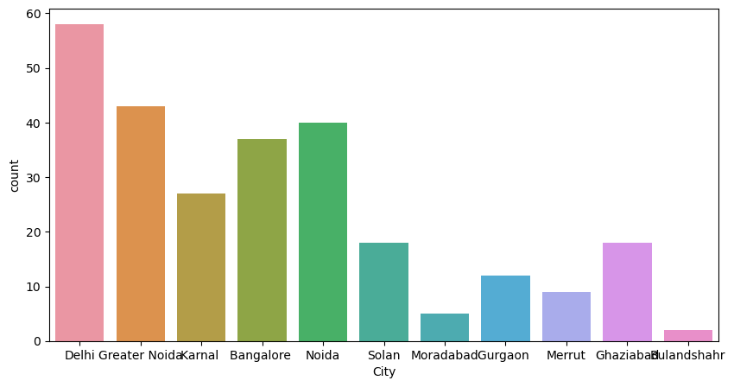
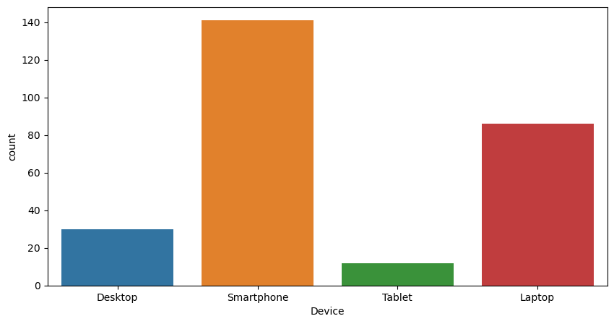
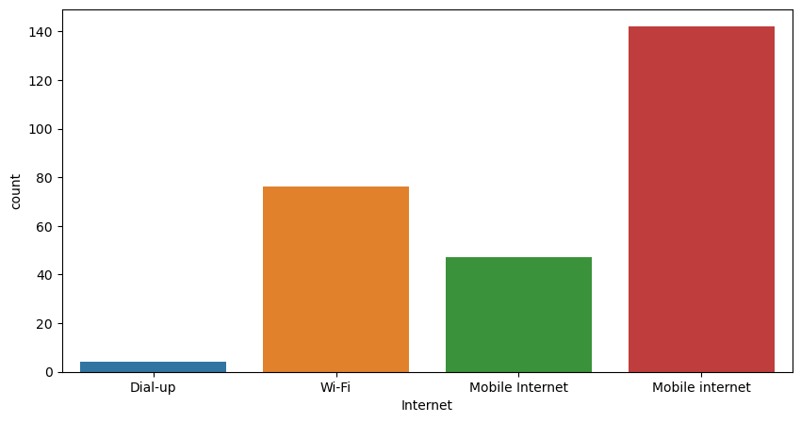
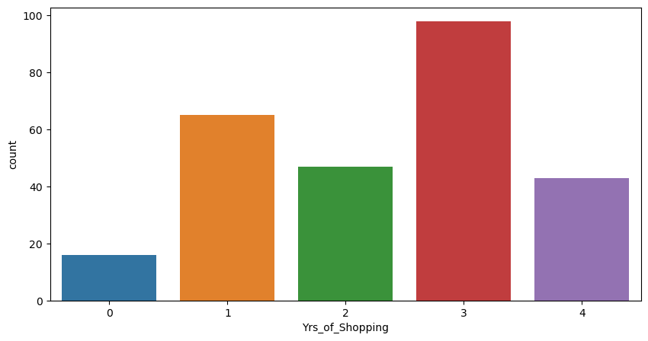
Univariate Analysis

Slide 16
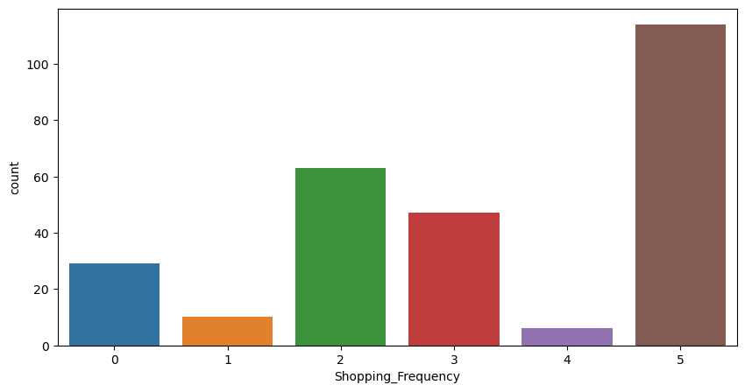
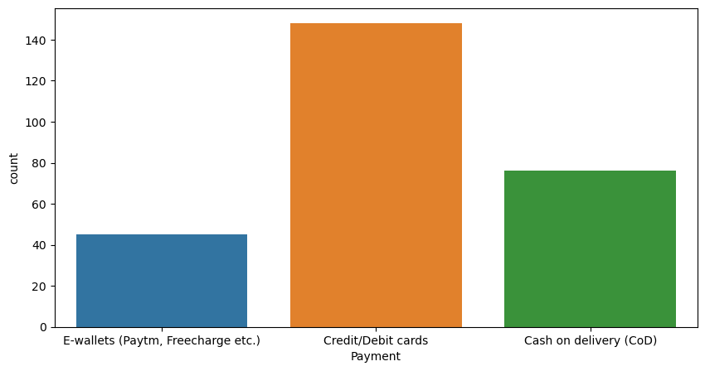
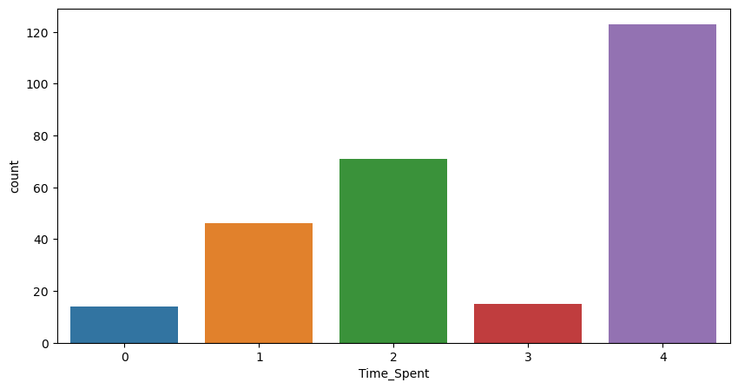

Slide 17
Observations from Univariate Analysis
Females are most interested in shopping as there are more that 50% women customers.
It can be observed that people having ages between 21-50 yrs are the customers who shop the most. The 31-40yrs category has the maximum no. of customers followed by 21-30yrs and 41-50yrs. The people aged between 51ys and above are the least ones to shop online.
Most of the customers from the city Delhi, Greater Noida, Noida and Bangalore are used to shop online and the shopping count is high in these cities.
Most of the customers found shopping online for more than 4 years and the count is high for the same followed by the customers shopping for 2-3 years.
In last 1 year, most of the customers were purchased online less than 10 times and only few of the customers purchased online 21-30 times.
Most of the customers used Smartphone device to access the online shopping and only few customers used Tablet to access the online shopping.

Slide 18
The count is high for others mobile screen size followed by 5.5 inches screen size and 5 inches screen size has least count. That means, the customers who have thier mobile screen size other than mentioned inches shopped more online followed by 5.5 inches and the customers having mobile screen size 5 inches shopped very less.
Most of the customers used Google chrome to access the website and only few of the customers used Opera and Mozilla Firefox to access the online shopping website.
Most of the customers used Search Engine and Via application to reach the online retail store after their first visit and also some customers used Detect URL to reach the online store. Which means these customers have downloaded their most favorite application to reach the online stores easily.
Many customers took more than 15 mins before making the purchase decision and some of the customers explored 6-10 mins.
Most of the customers abandoned their shopping cart sometimes and some of the customers abandoned their shopping cart frequently.
Around 133 customers abandoned their bag due to some better alternative offer and 54 customers abandoned due to promo code not applicable.

Slide 19
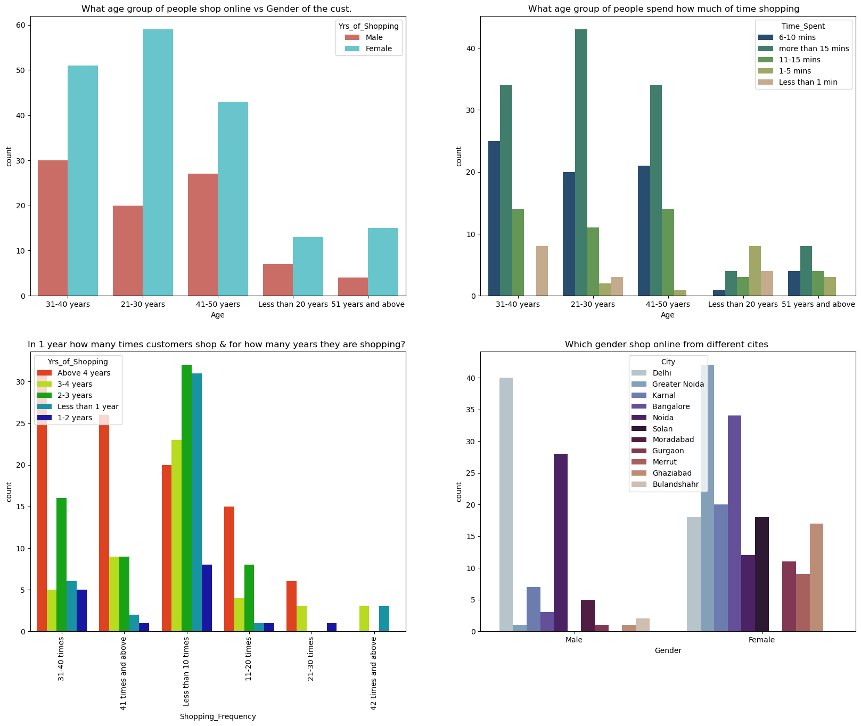
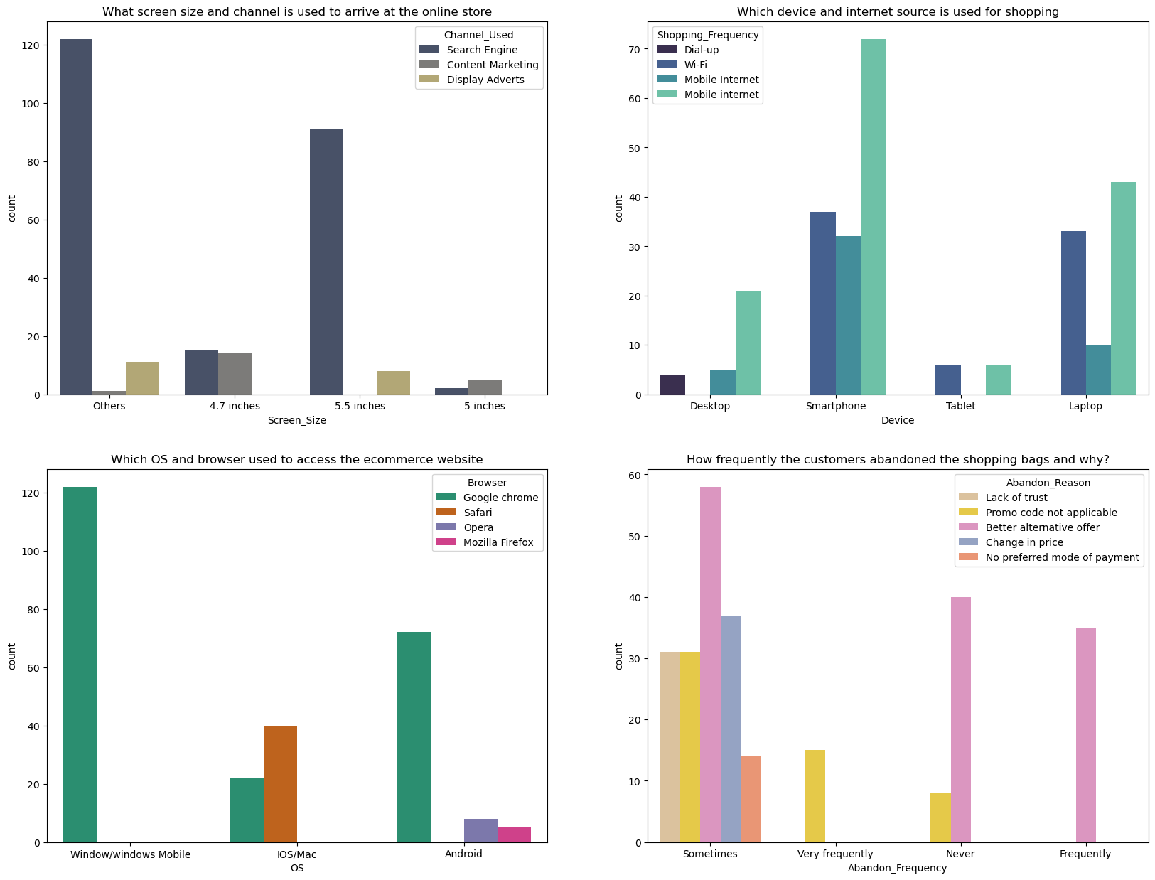
Bivariate Analysis

Slide 20
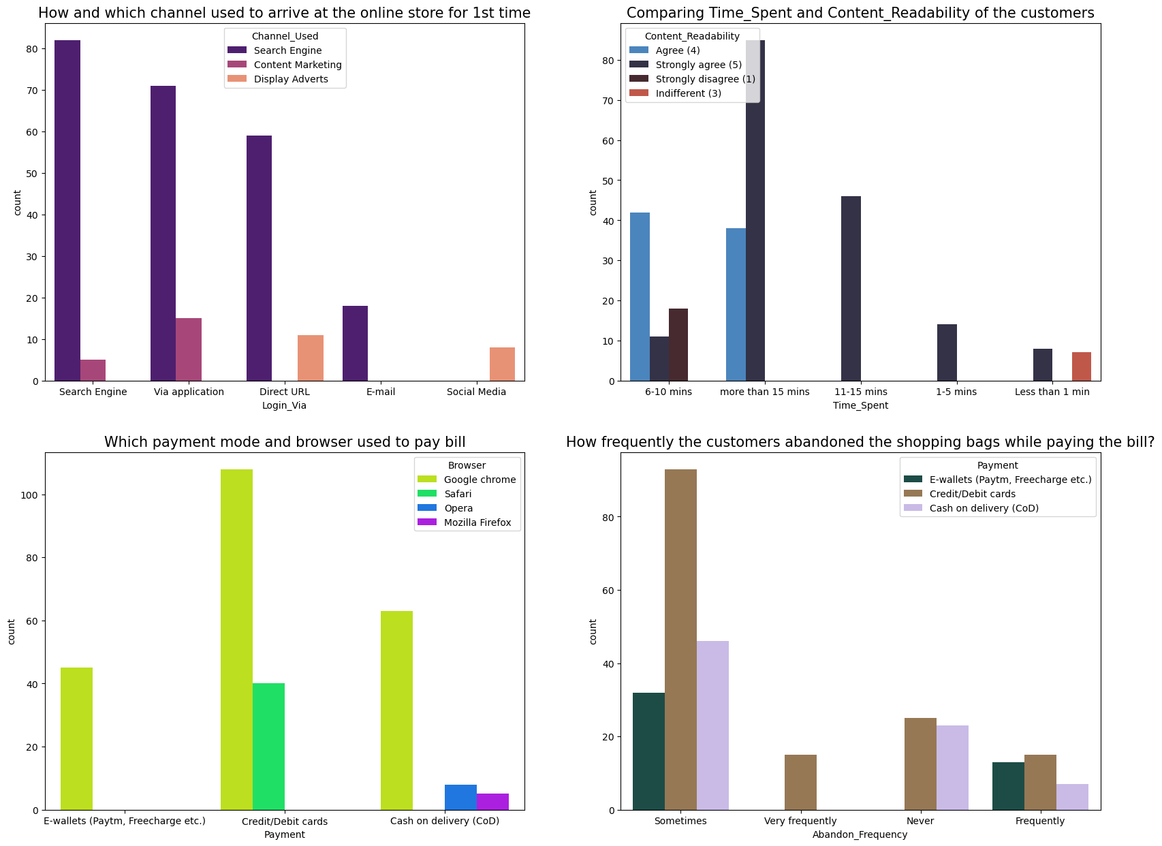
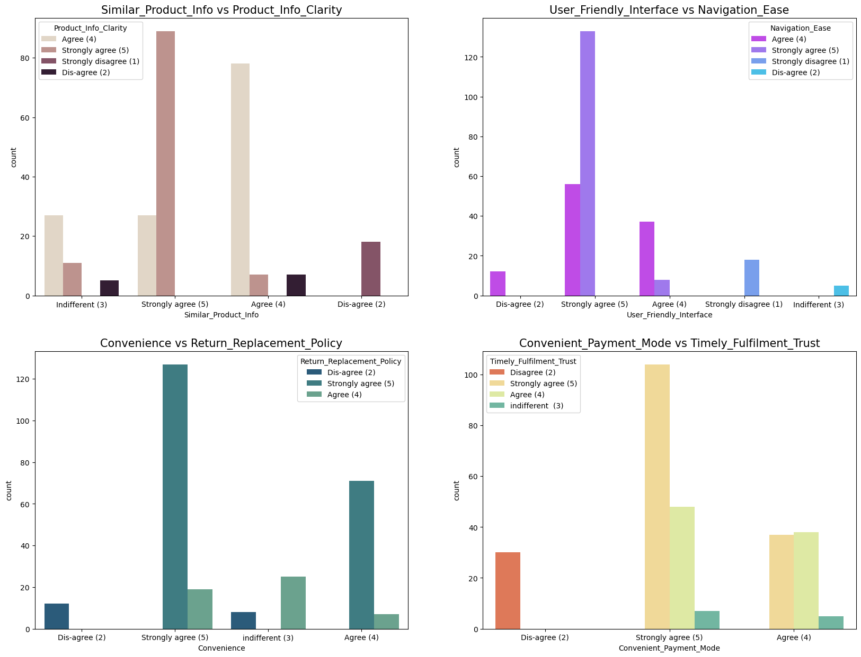

Slide 21
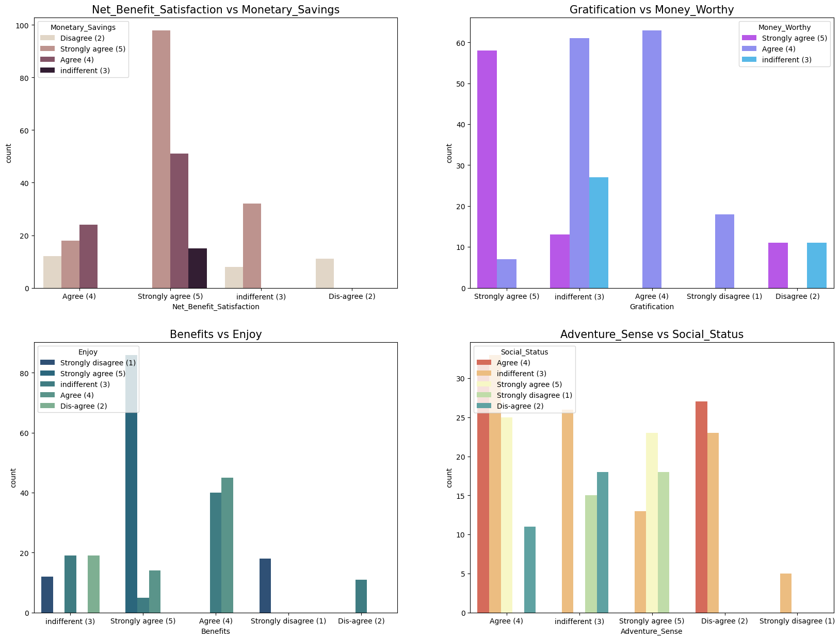

Slide 22
Observations from Bivariate analysis(Experiences of customers)
Females from every age group tends to shop more than male. Female from the 21-30 yr age group has the highest rate of shopping where as less than 20yr and 51 yr above age group has least no. of customers.
Age group of 31-40yrs,21-30yrs and 41-50 yrs all customers spend more than 15 mins to make a decision to shop products. And the age group less than 20yrs and 51 yrs above spend the least time for shopping.
The customers who are shopping for more than 2,3 and 4 yrs shop atleast 31-40 and 41 times and above a year. There are also customers who shopped for a few months to 1,2 and 3 yrs and shop atleast 10 times a year. There are very less customers who shopped for 42 times and above a yr.
Most of the female customers shopped online for more than 4 year and the count is also high for the females who shopped from 2-3 years. And only few male customers shop online more than 4 years.
Most of the female customers tend to be from Delhi, Greater Noida and Bangalore.
The channel mostly used by the customers is Search engine and tend to use screen size of 5.5 inches. Content marketing and Display Adverts are the least used channels.
Shoppers uses their smartphones the most for the most for online shopping and so it can be related that most of the customers uses mobile internet as their source for browsing.
Windows and Android are used the most to search online products and the most used browser is Google chrome by the customers.

Slide 23
There are sometimes when the customer abandons the shopping bags due to better alternative offers, change in price , lack of trust and Promo code not applicable. Where as there are also some customers who never or frequently abandon the shopping bag due to better alternative offers.
Every first time of the customer, they preferred to use Search Engine and Applications.
As the content readability is good customers spend more than 10 and 15 mins to shop products online.
As most of the customers uses Google Chrome for e-stores it can be observed that more than 50% of the customers make choices to make the payments by Credit/Debit cards followed by Cash on Delivery and the least by E-wallets. There may be a sense of lack of security while doing the transaction by E-wallets that is why most customers avoid doing transactions through it. Customers using Mozilla Firefox and Opera browsers tend to opt for Cash on Deliveries.
There seem to be issues while doing the transaction via Credit /Debit cards to the customers as there is a high rate of abandoning the shopping bag sometimes.
Almost all the customers Strongly Agree that the ecommerce websites should provide a clearer search for the similar product information and there should be a Product information clarity provided.
Most of the customers Strongly agrees that appropriate User-friendly interface can give them a great satisfaction while browsing for products which also can ease navigation on the ecommerce websites. If websites are easy for the navigation customers cannot feel ambiguous while making choices. There are not many customers who disagrees with the easy navigation and User-friendly interfaces of websites.
Most of the customers agreed that return and replacement policy of the e-tailer is important for purchase decision also helping in the convenience and ease for shopping. Return and Replacement policies tend to give a sense of security to the customers about their money and products they are buying. Maximum of customers find it convenient to shop from ecommerce sited that provide return and replacement policies .

Slide 24
Almost all the customers strongly agree to have convenient modes of payment which helps the e-retailer to gain trust of the customers.
Most of the customers agreed that the online shopping gives monetary benefits and responsiveness which also gives high amount of net benefit satisfaction. So it is important for the online shopping websites to give monetary benefits if they want to retain their customers.
Most of the customers believed that the more benefits given by the ecommerce websites while online shopping tends to shop more and enjoy the experience of shopping. There are various benefits and campaigns run by the ecommerce sites all over the year which includes heavy discounts on various products.
Customers agrees to the point of social status and adventure sense. It can be observed that maximum of the customers enjoys having a social status and gives them a feeling of Adventure sense

Slide 25
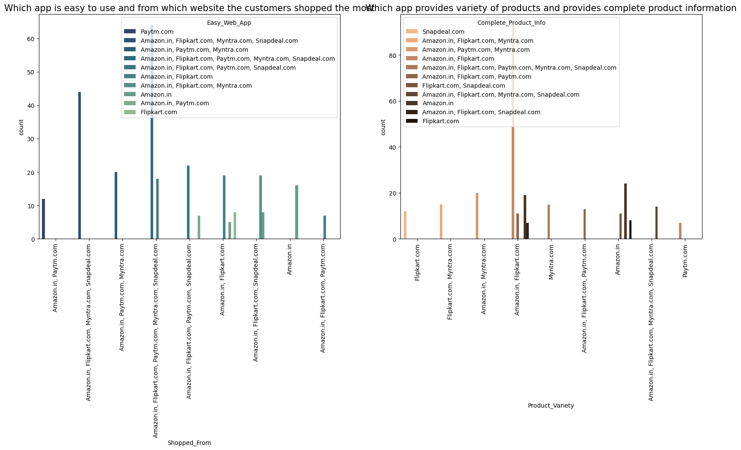
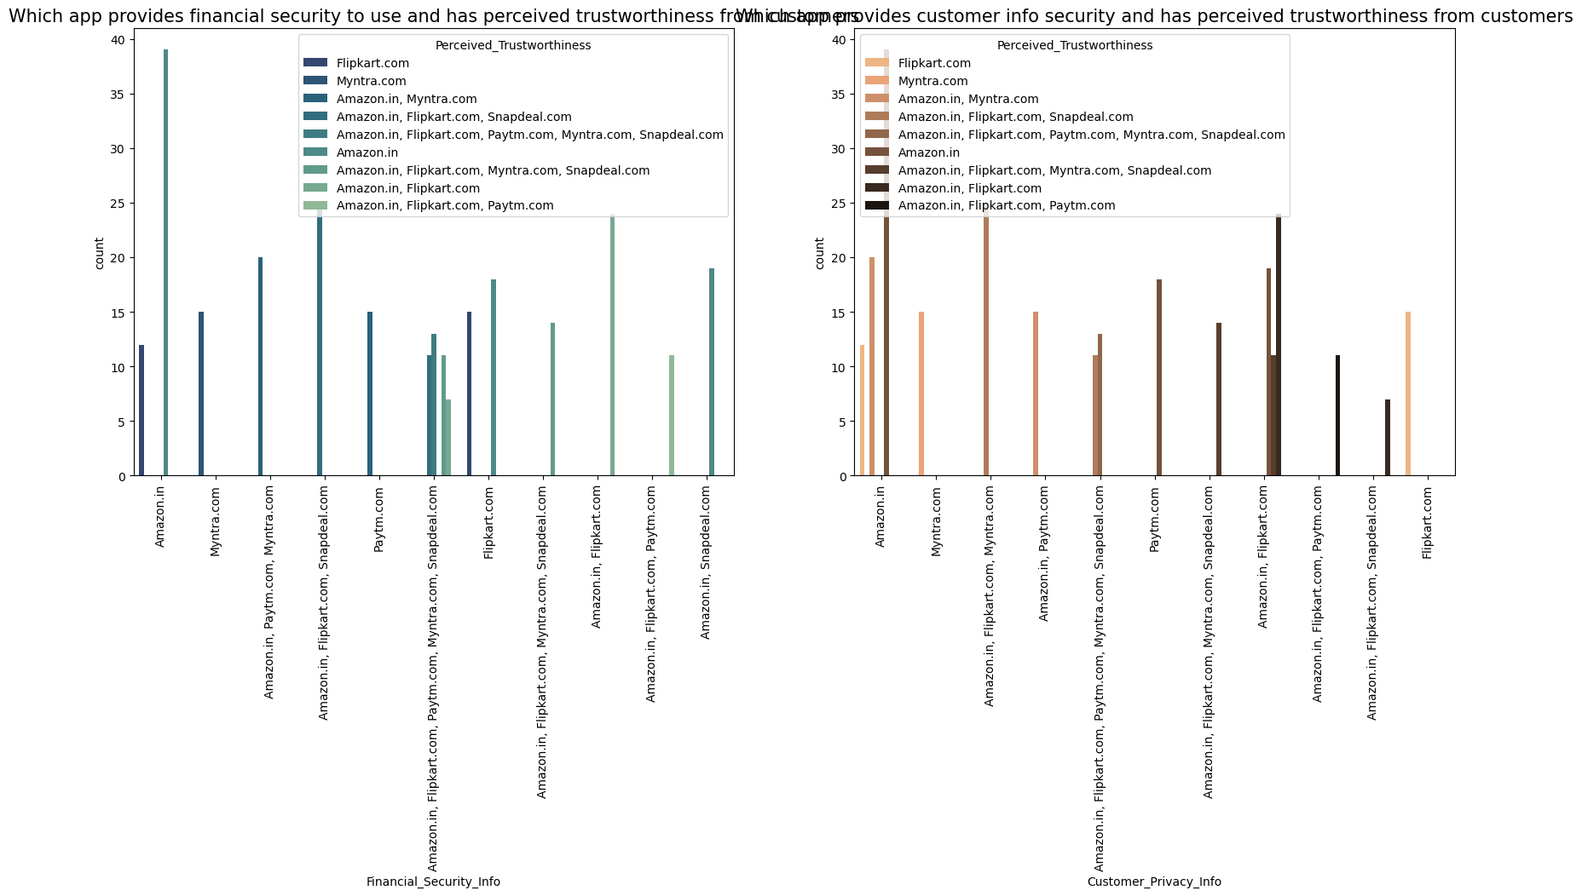

Slide 26
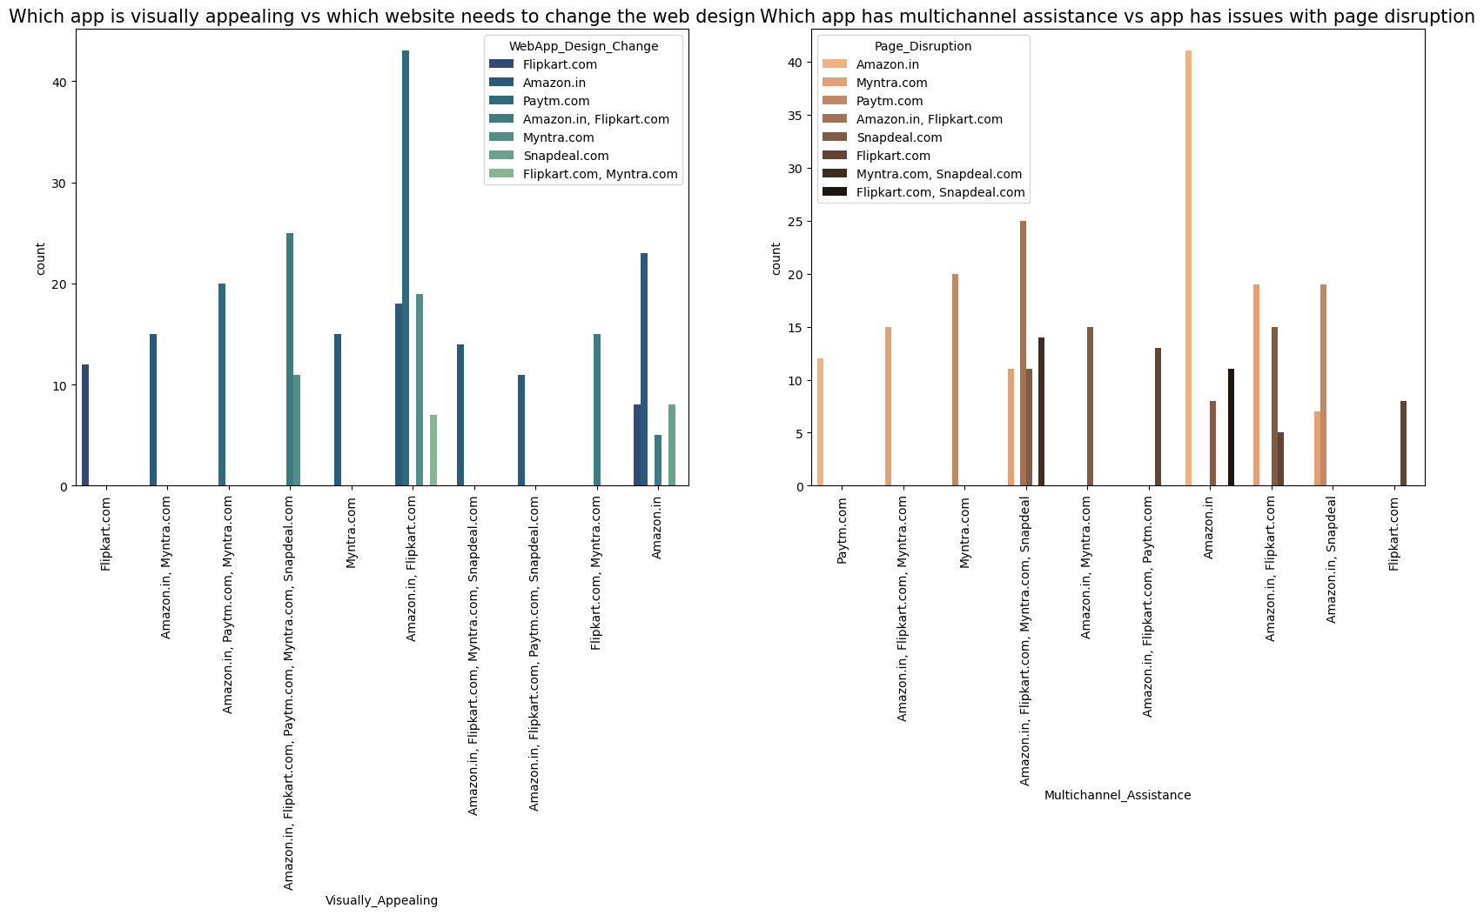

Slide 27
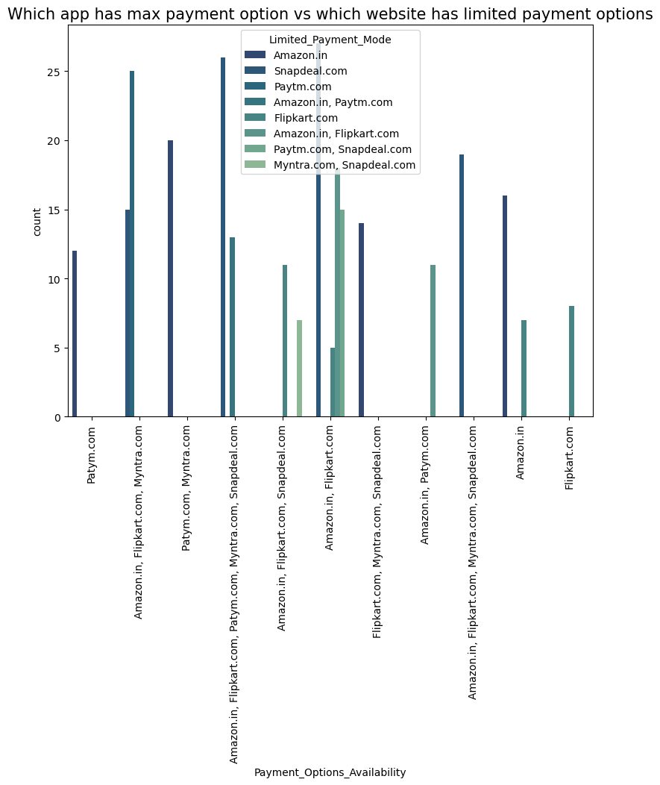
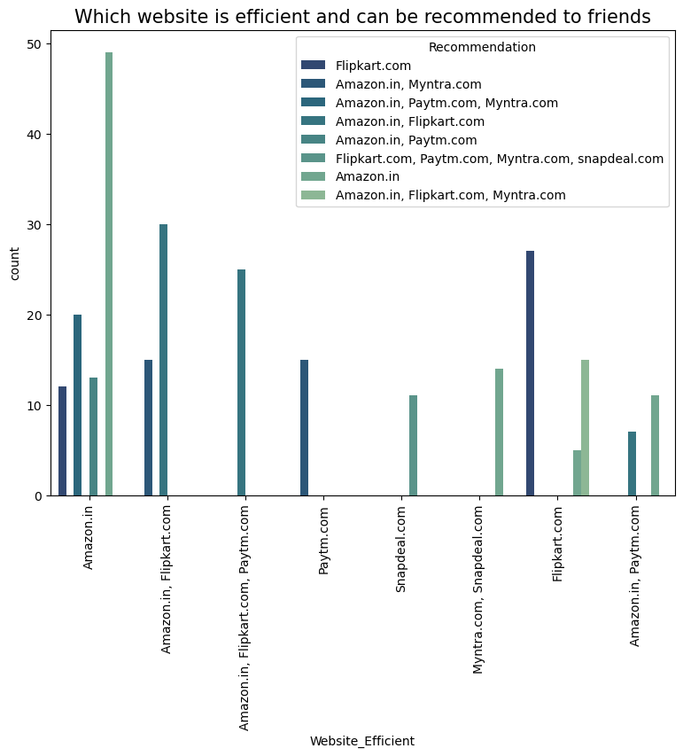

Slide 28
Observations for Bivariate Analysis of different platforms
Above 50% of the customers uses Amazon.in Flipkart.com Paytm.com, Myntra.com and Snapdeal.com as the shopping platforms which are also easy to use. The reason of using these websites for shopping must be a good user interface.
Amazon.in Flipkart.com provides the highest rate of product variety which can also be a reason to gain popularity among the customers. These websites provide a complete product information which helps customers to make purchase decision easier and wiser.
The customers financial information security and the privacy of the customers personal information is the highest priority of the websites to keep it safely and not leak the information. Amazon. In tends to be the most trustworthy sites in the sense of Financial Information security of a customer followed by Flipkart.com Paytm.com, Myntra.com and Snapdeal.com. These sites gain the highest rates for perceived trustworthiness.
There are a lot no. of customers who purchase products from amazon.in and it can be observed that all of them agrees that the website is visually appealing but still thinks that there should be a web design change in it which is same in the case of Flipcart.com. Users have a opinion of changing the web designs of almost all the sites though they use the same for shopping.
Amazon.in gives a higher rate of multichannel assistance and at the same time has issues with the page disruption followed by the sites Flipcart.com and Myntra.com. Snapdeal has limited mode of payment on most of the products followed by Amazon. Having different types of payment methods will helps the customers to pay the invoice easily using their choice of payment and if the websites have speedy delivery methods without delivery charge, then the customers like to buy the products in those websites.
Amazon is the website which is more efficient as Amazon.com. Also Amazon.in, Flipkart and Myntra are the highly recommended online retailer sites for purchasing all types of products, as they provide enormous amounts of benefits.

Slide 29
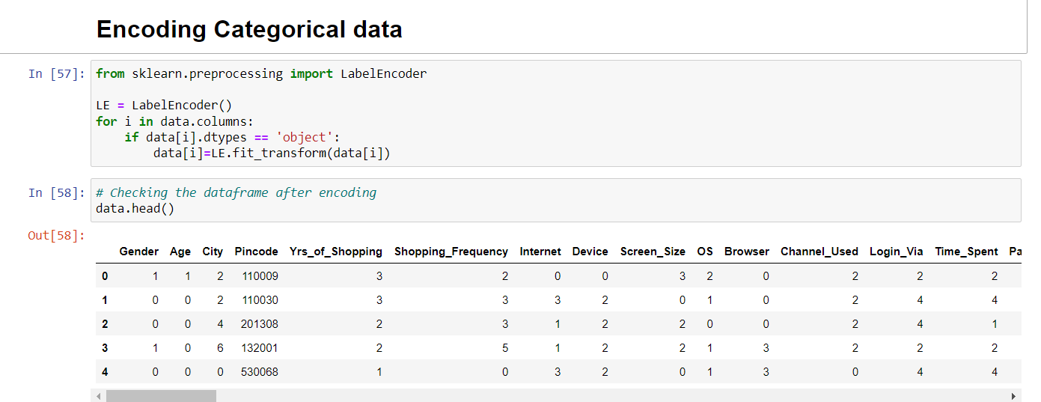
Encoding Categorical data

Slide 30
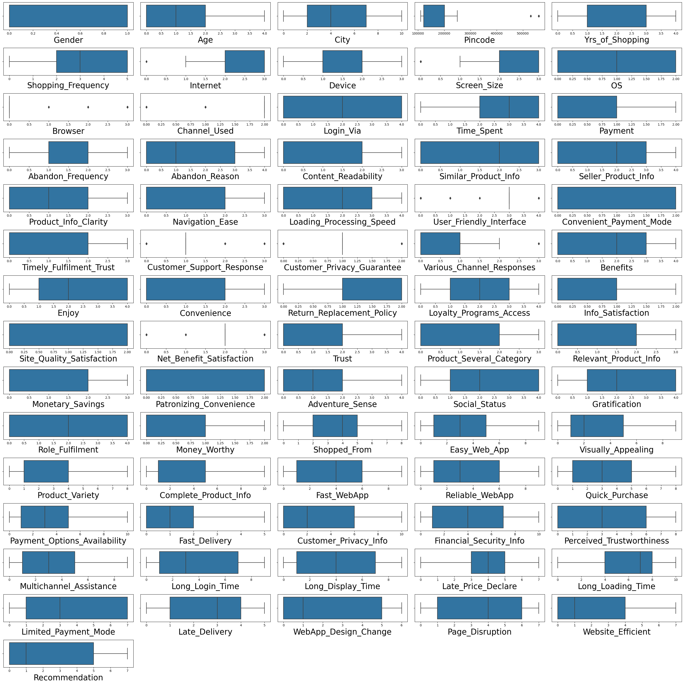
Identifying Outliers

Slide 31

Checking Correlation
This heatmap shows the correlation matrix by visualizing the data. we can observe the relation between one feature to other.
This heat map contains both positive and negative correlation.
1.Dark shades are highly correlated.
2.Light shades are less correlated.
3.By looking at the heat map it can be observed that most of the columns have strong correlation with each other, which leads to multicollinearity issue and it will impact on the model accuracy.

Slide 32
Concluding Remarks
The endeavour of this study is to identify the motivating factors towards online shopping and in which re-tailer the customers likely to shop more. In this project we have investigated ecommerce quality in online businesses and develop new knowledge to understand the most important dimensions of E-retail factor for customer activation and retention.
From the analysis it was found that consumers purchasing decisions were dependent on various factors. All these motives motivate consumers to purchase products through online. According to consumers' opinions, "time saving" is the most important motivating factor for online shopping.
After visualizing the data, I found Amazon is the best online store where the customers trust on buying products and it has positive impact on the customers. Also, amazon and flip kart have increased customers’ expectations. So, they are the best online retailer who makes the loyal customers and satisfies the customers.
It was also observed that online shopping is not trustworthy and reliable to some consumers due to only online payment system and personal privacy. In addition, online security is a major concern for the consumer particularly in terms of fraud, privacy and hacking. So, the organizers should make up their organization for better sales.
Customer satisfaction and customer trust appeared as the outcomes of overall e-retail factor. The results of the analysis showed that e-retail factor had a positive impact on customer satisfaction

Slide 33


